Slide 1
Scene Graphs and Animation
Jacob

Slide 2
Outline
Scene Graphs
Animation
Quick Demo

Slide 3
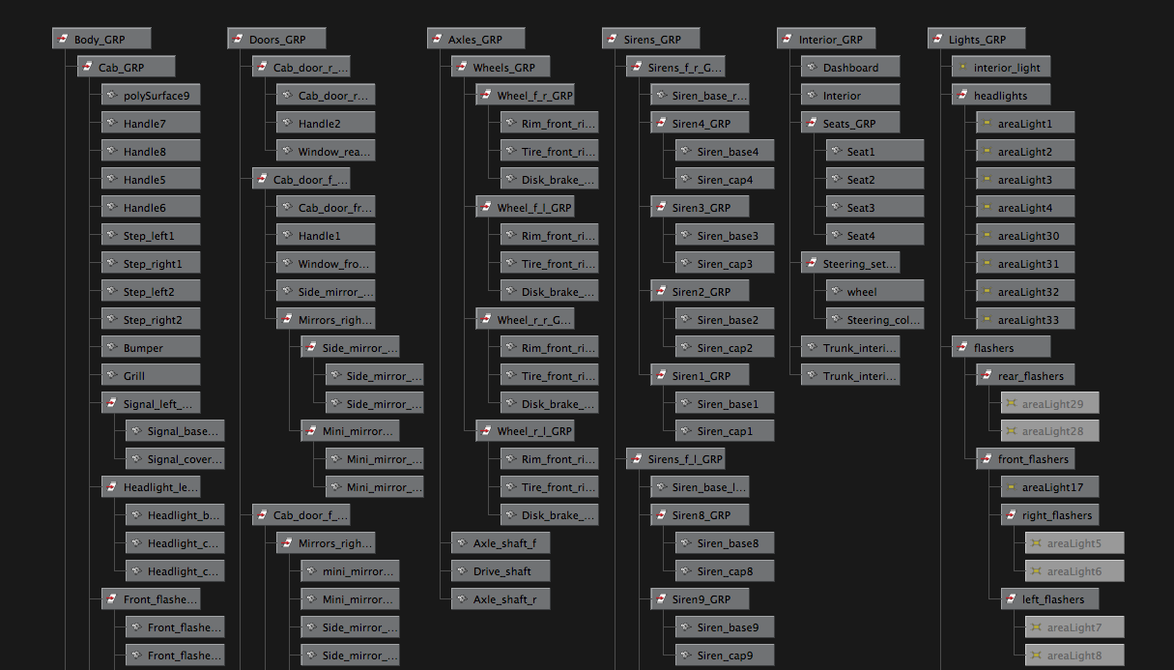
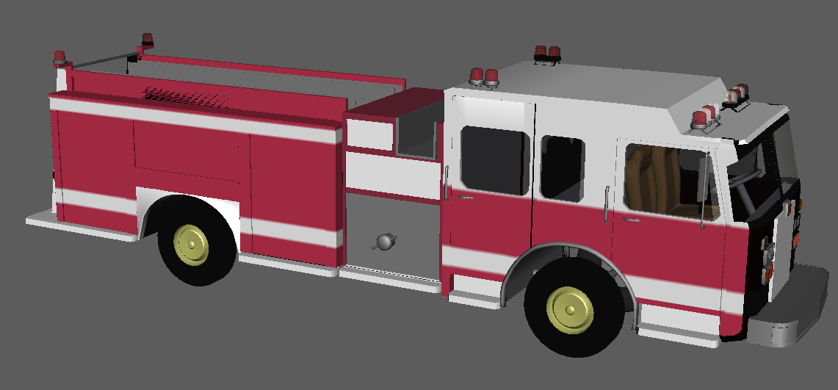
Scene Graphs
“A general data structure commonly used by graphics applications which arranges logical and spatial presentation of a graphical scene.”
- Wikipedia
Notes:
Read definition
Explain pictures
Didn’t make much sense to me at first but hopefully will as we talk about
How are scene graphs made and why are they useful

Slide 4
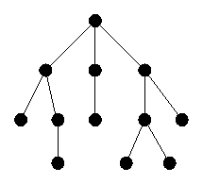
Scene Graphs
“Collection of nodes in a graph or tree structure that group related objects that can be moved, transformed, and selected as if they were a single object.”
- Wikipedia
Notes:
Organization: Group related objects together
Transformation: scaling, translation, rotation

Slide 5
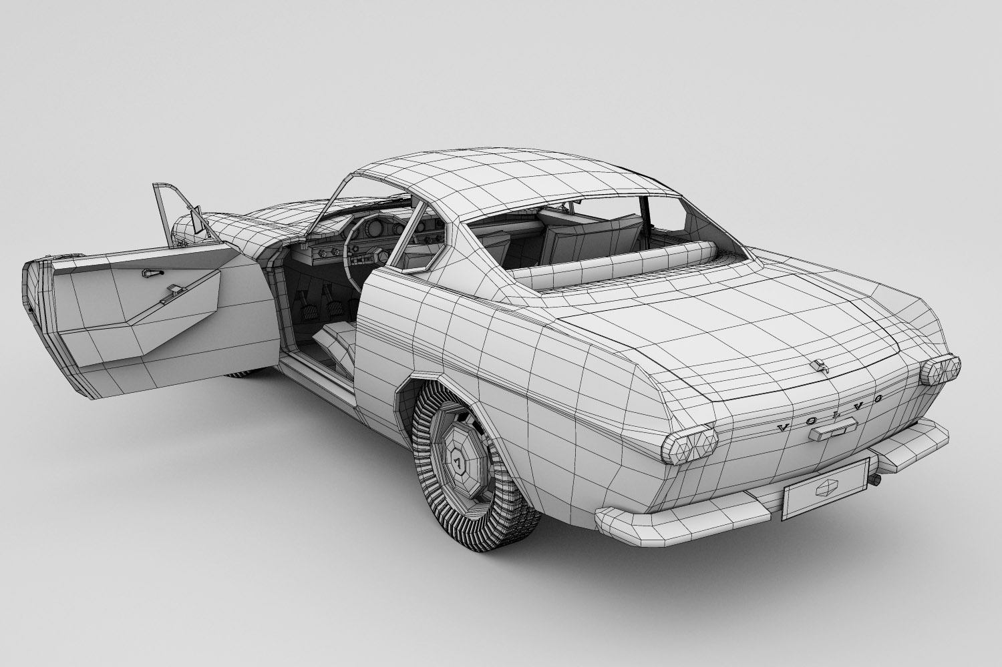
Notes:
Picture of Car
Made up of individual objects, similar to how our dog was made up of individual parts (legs, torso, eyes).
Car made up of individual objects all rendered together to form a car
May want to make the car bigger or smaller
Scale car by 2x, scale wheel by 2x but also translate wheel to new body location
Rotate the car
Could just make whole car one big mesh
But then we couldn’t move individual parts

Slide 6
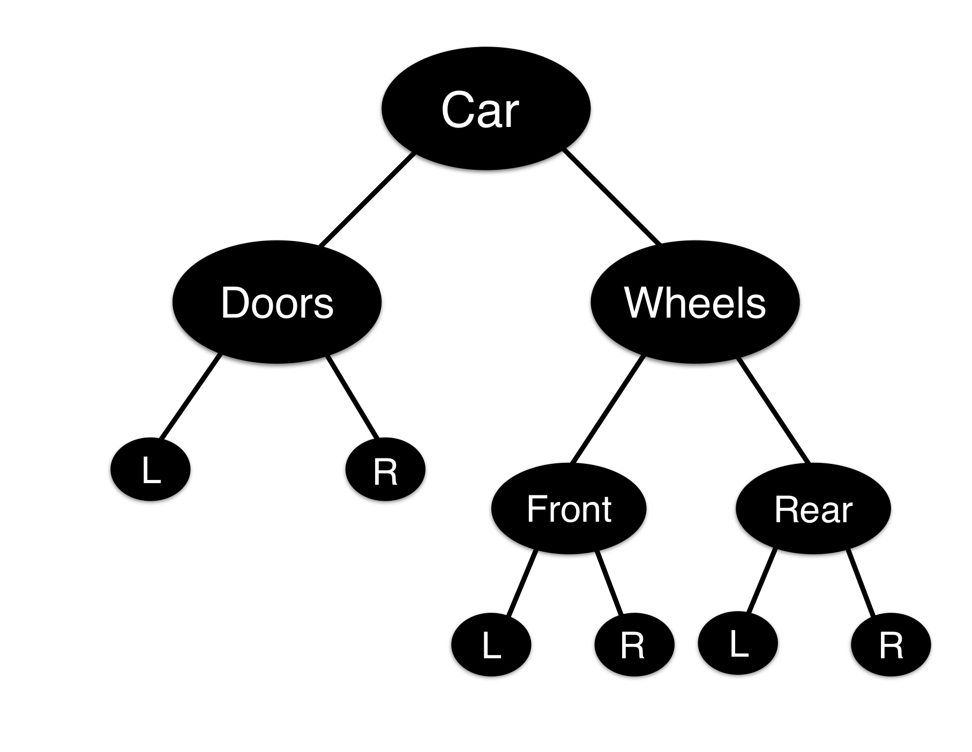
Scene Graphs
Notes:
Scene Graph of Car
Node represents what we’re referencing or selecting
As you go down the tree, more specific
Open Left Door
Rotate all wheels
Turn front wheels
Organized object in scene by grouping similar objects
Translate, rotate, and scale multiple objects as if a single object

Slide 7
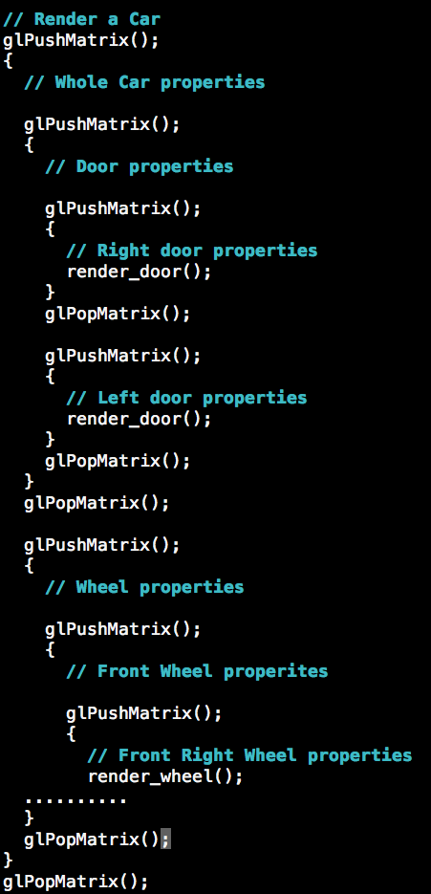
Scene Graphs
Notes:
Concept of SG analogous to the way we pushed and popped matrices in OpenGL
I only bring this up as an interesting connection to stuff we’ve already seen

Slide 8
Outline
Scene Graphs
Animation
Quick Demo

Slide 9


Animation
“Animation is the process of making the illusion of motion and the illusion of change by means of the rapid display of a sequence of static images that minimally differ from each other.”
Traditional Animation:
Each frame is hand drawn
Cel animation
Lion King
Computer Animation:
3D animation digitally modeled
3D Polygon Mesh (triangles)
Keyframes
Rigging
Pixar films

Slide 10
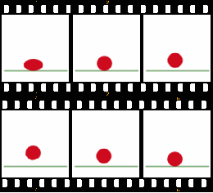

Traditional Animation
Notes:
-rapidly display these frames to create illusion of motion for a ball

Slide 11
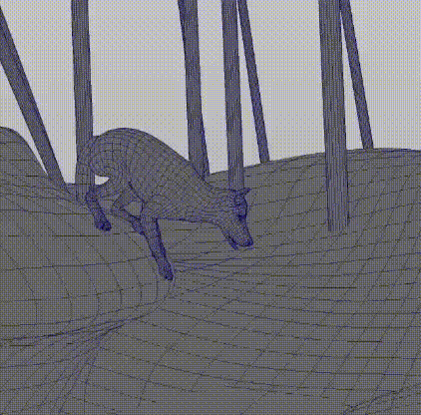
Computer Animation
Notes:
3D polygon mesh
Hard with traditional animation
Short animation has hundreds of frame
Not even a high framerate

Slide 12
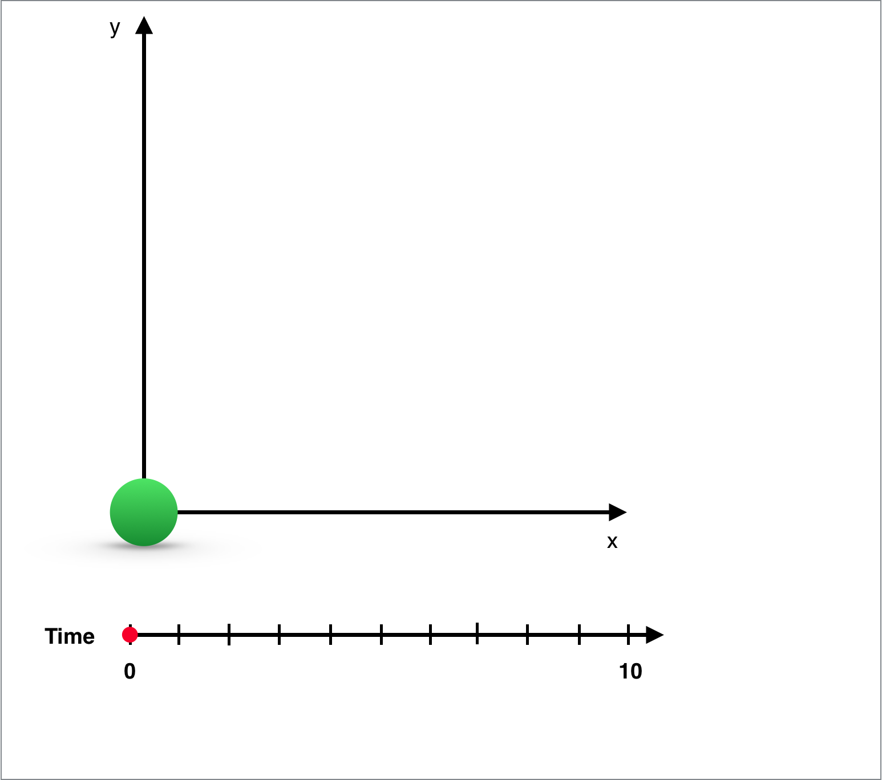
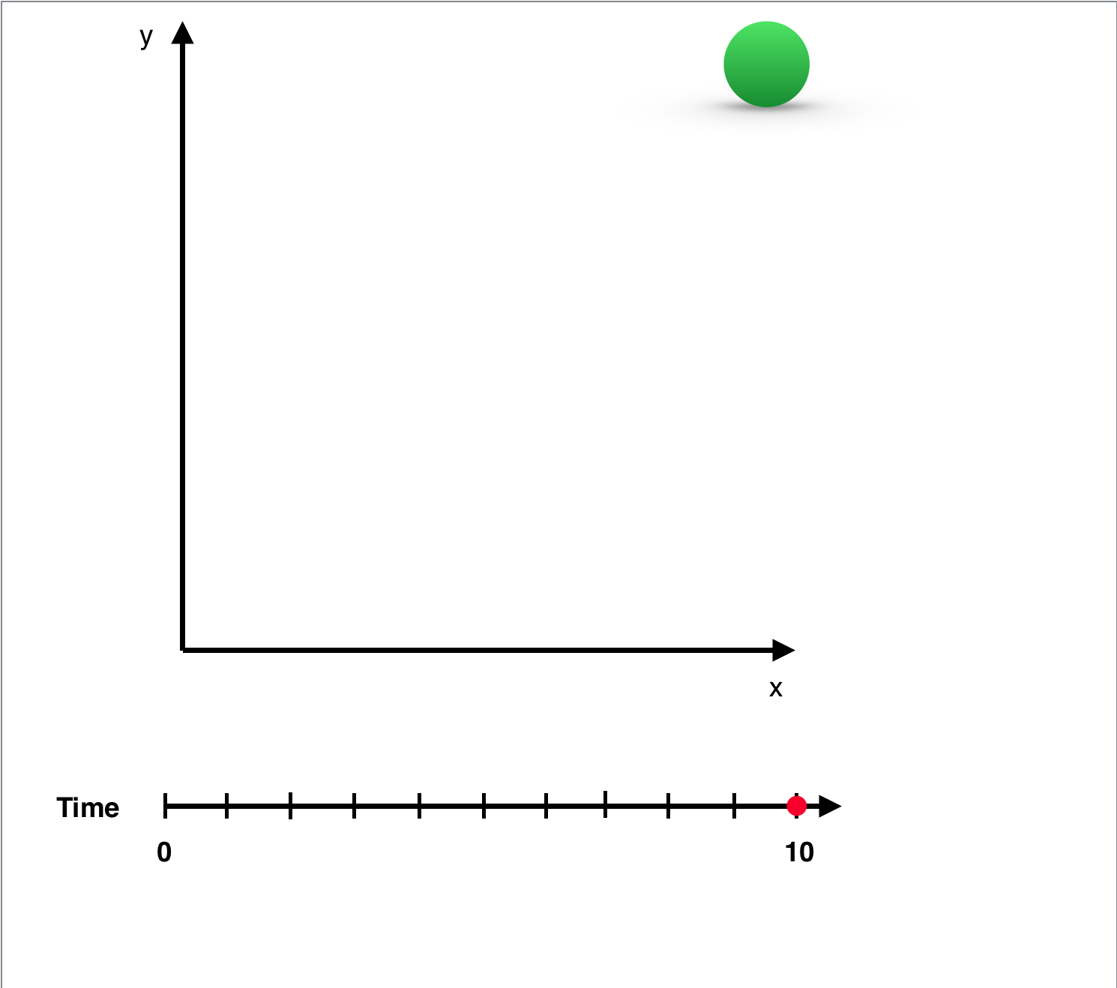
Key Frames
Key Frame 1
Object: Sphere
Time:0
X: 0
Y: 0
Rotation: 0
A key frame is a “snapshot” of an object’s properties at a given time.
Key Frame 2
Object: Sphere
Time:10
X: 1
Y: 1
Rotation: 0
Notes:
Some time talking about keyframes
In the context of animation

Slide 13
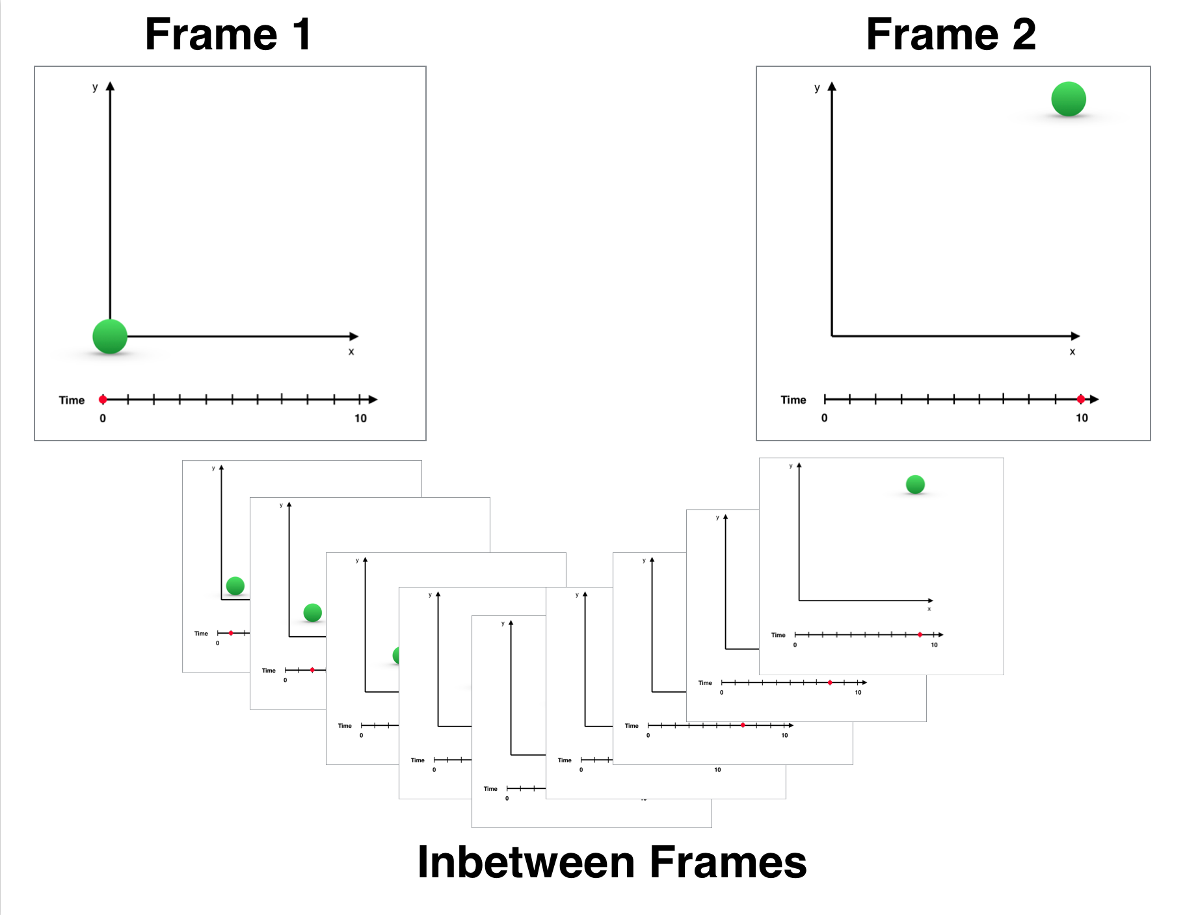
Inbetweening
The process of generating intermediate frames between two images to give the appearance that the first image evolves smoothly into the second image.
Notes:
Objects attributes are interpolated across time

Slide 14
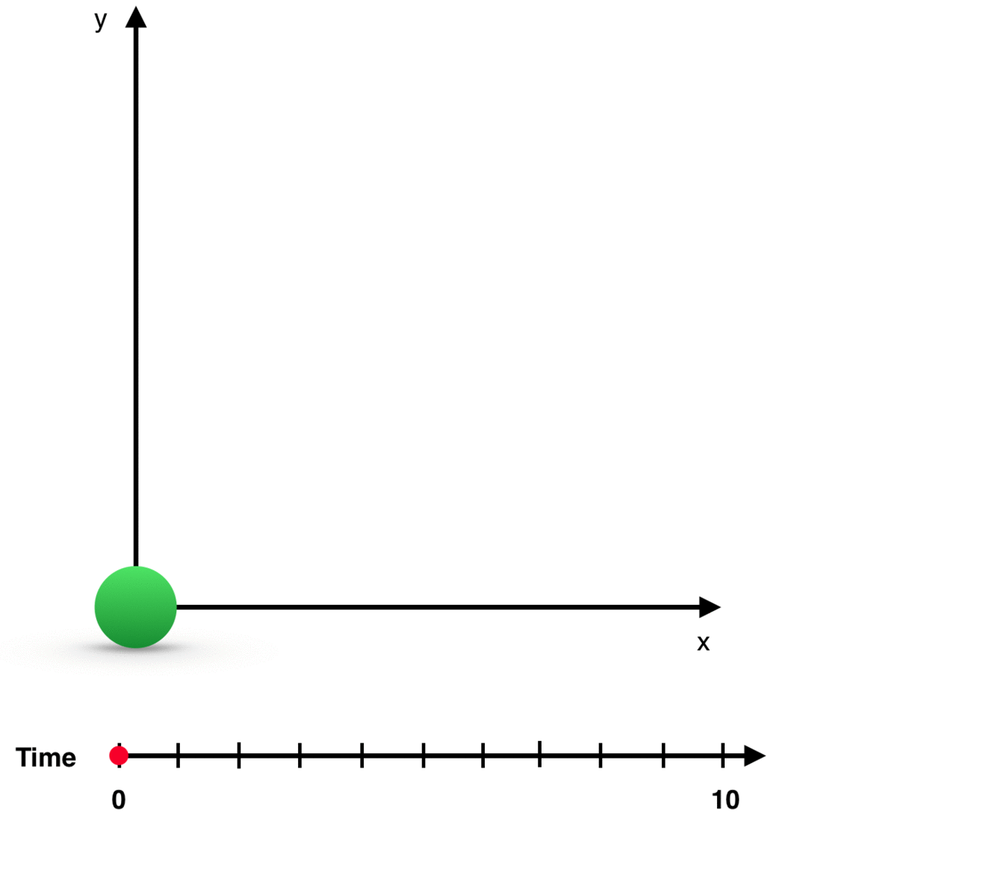
Resulting Animation (LERP)
Notes:
Main point
In computer animation you can use key frames and inbetweening to create this illusion of motion

Slide 15
12 Basic Principles of Animation
Introduced in 1981 book from Disney animators
“The Bible of Animation”
Important for creating a realistic illusion of motion
Squash and Stretch
Anticipation
Staging
Straight Ahead Action and Pose to Pose
Follow Through and Overlapping Action
Slow In and Slow Out
7. Arc
8. Secondary Action
9. Timing
10. Exaggeration
11. Solid Drawing
12. Appeal
Notes:
Originally in the context of traditional animation
Things you may not immediately think about when doing an animation. Once you read about these and go watch an animation you can definitely see them being used.

Slide 16
Principles of Animation: Squash and Stretch
Notes:
Arguably the most important principle
Captures elasticity of motion

Slide 17
Main Points
Scene Graphs:
Organize scene by grouping similar objects
Allow selecting, modifying multiple objects as if one object
Animation:
Illusion of motion by rapidly displaying frames
Animation created using Key Frames and Inbetweening

Slide 18
Outline
Scene Graphs
Animation
Quick Demo
Notes:
Wanted to do demo live but I didn’t have a way to do it, so I have a video

